Slide 1
Oh no, GMOs!
Debate

Slide 2
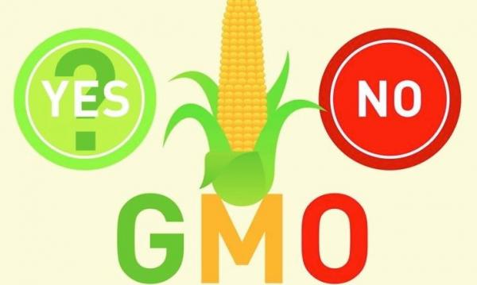
InstaPoll
When you think of GMOs, what is your first reaction?
Scary – I don’t want to eat “Franken-foods”!
Yummy - I love those big, fat, juicy GMO papayas.
What are GMOs…?

Slide 3
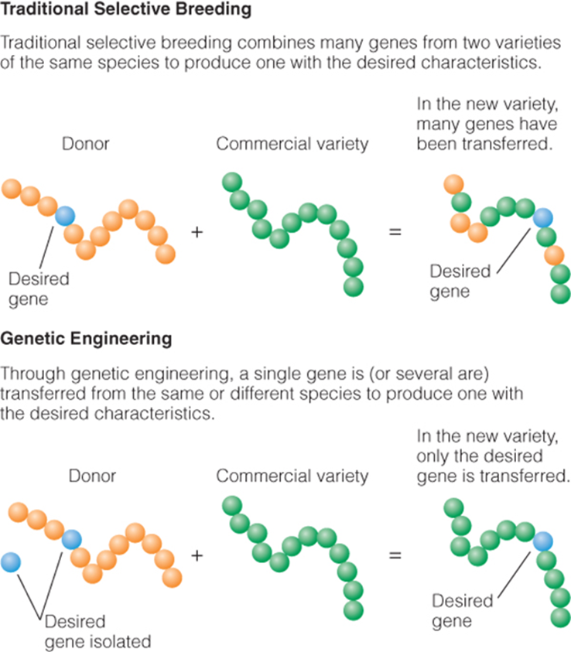
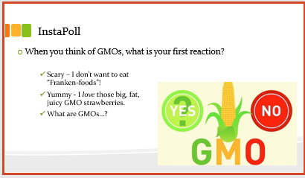
GMO- Defined
Biotechnology: The science of manipulating biological systems or organisms to create or modify their products.
Genetic engineering:
Insert or modify genes to express new trait or modify existing traits
Rapid and dramatic changes
Faster and more precise process than selected breeding
Products of this technique: GMO (Genetically Modified Organism)

Slide 4
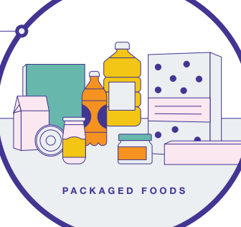

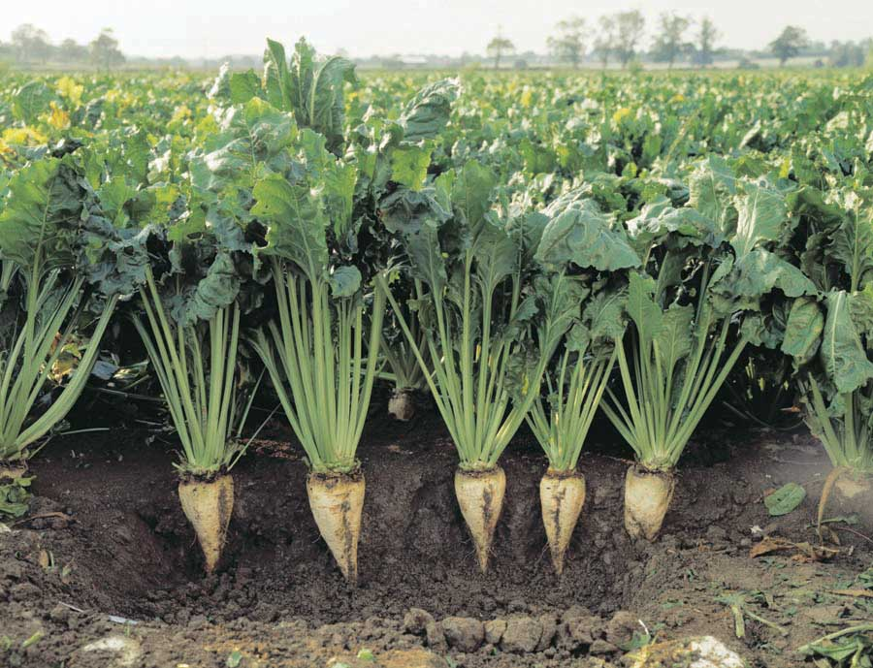
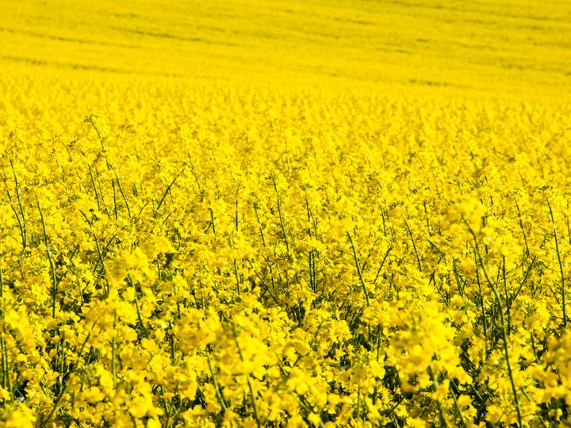
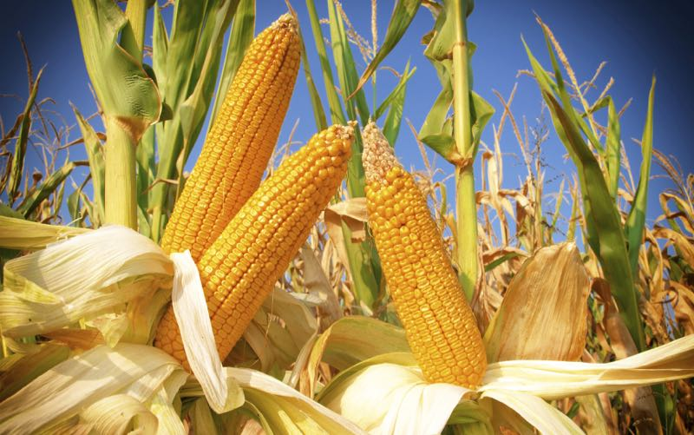
GMO Crops - Packaged Foods
Sugar Beet
99.9% are GMOs
Used for granular sugar
>50% granular sugar is GMO
Corn
92% are GMOs
Used for foods & drinks
Canola
95% are GMOs
Used for
cooking oil
margarine
food consistency

Slide 5
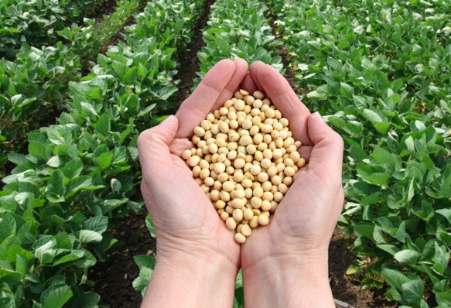
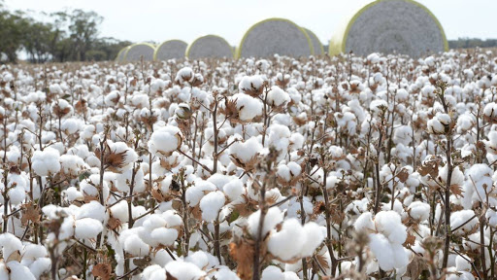
GMO Crops - Packaged Foods
Soybean
94% of soybean planted is GMO
Used for ingredients
lecithin
emulsifiers
proteins
Cotton
94% of cotton planted is GMO
Used for cottonseed oil (cooking)

Slide 6
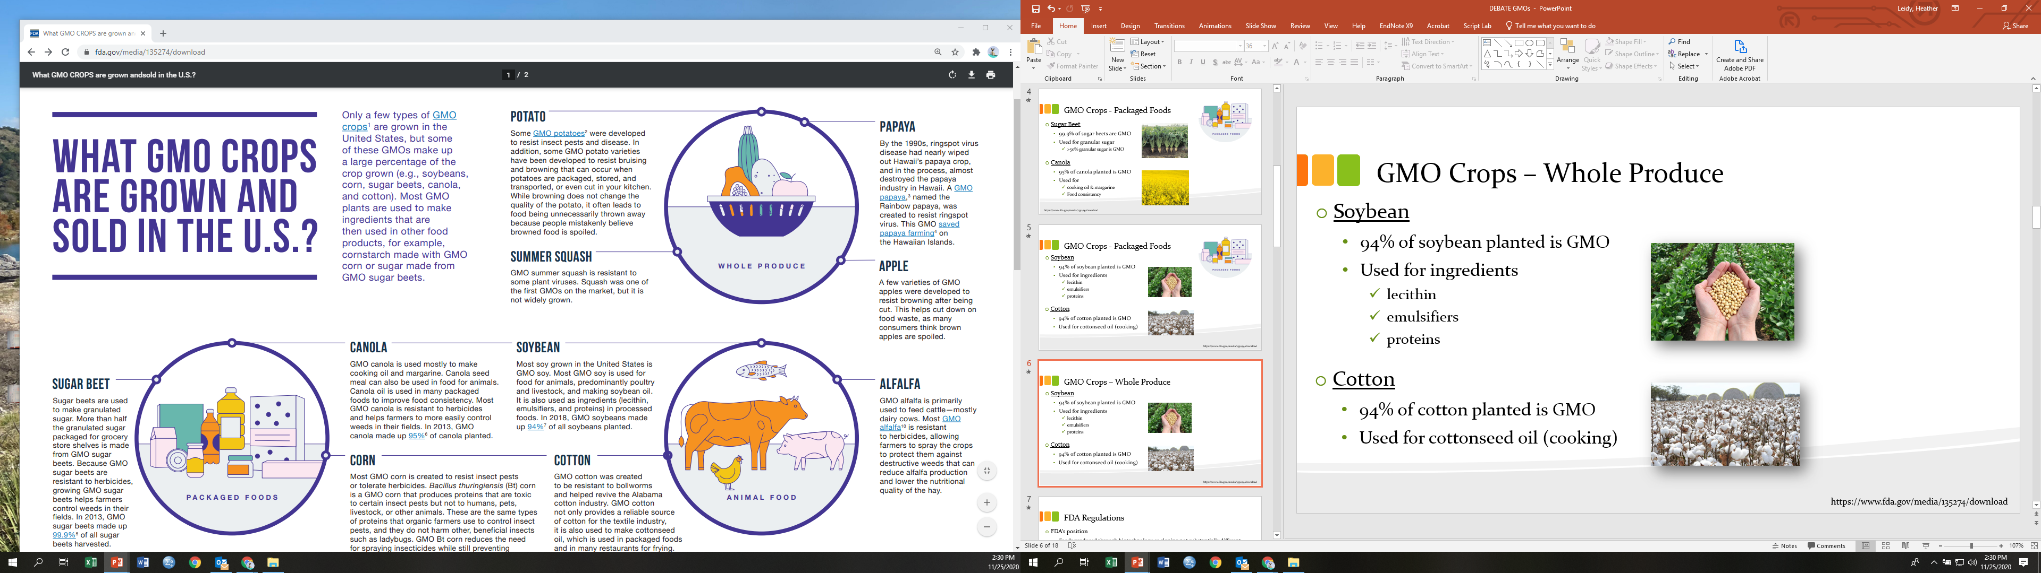
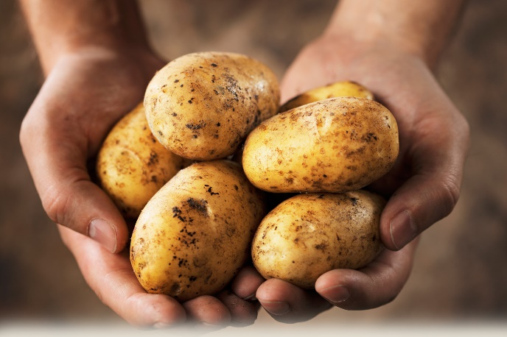
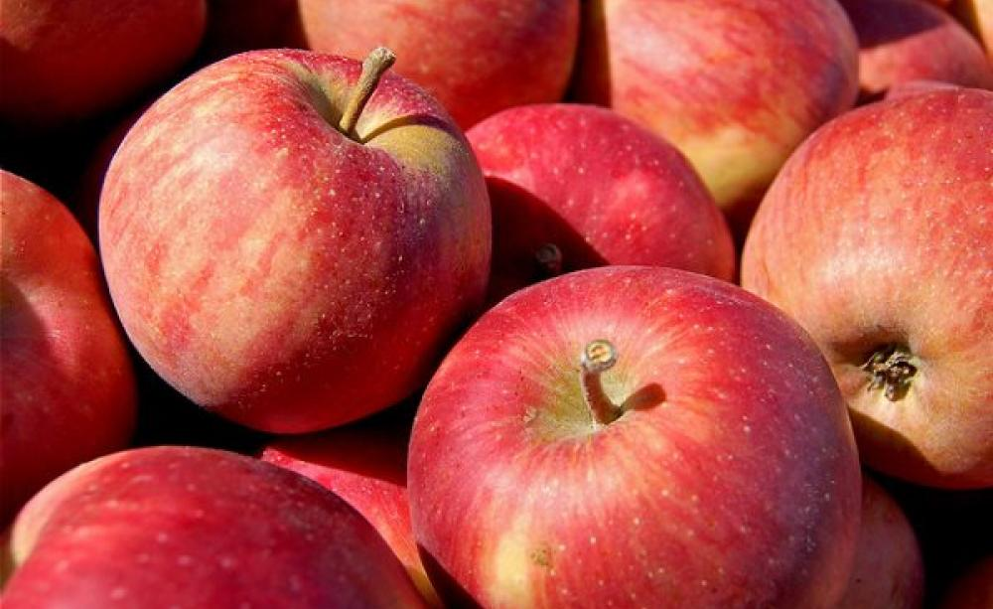
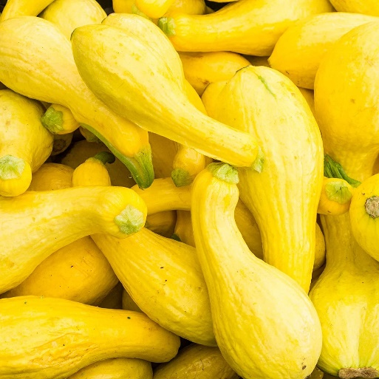
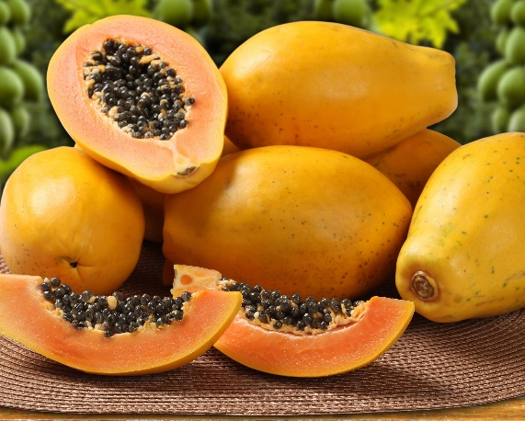
GMO Crops – Whole Produce
Potato
Apple
Summer Squash
Papaya

Slide 7
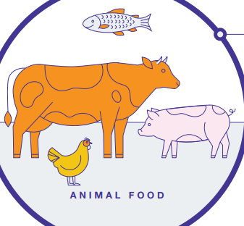
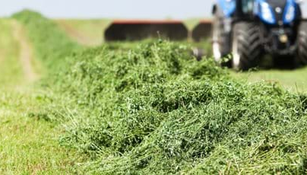
GMO Crops – Animal Feed
Soybean
Cottonseed
Alfalfa
Corn

Slide 8

GMO Chat
3 minute discussion in small group chat groups:
Do you consciously eat or avoid GMO foods…?
Why?
How do you know which foods contain GMOs?

Slide 9
Debate Format
Each topic will have a point and counter-point
½ of the points will support & ½ will refute GMO foods
Michele: In support of GMO foods
Heather: Refuting GMO foods
‘Ask a question’ will occur throughout the debate - feel to ask questions!
Check your biases at the door and openly listen to both sides

Slide 10
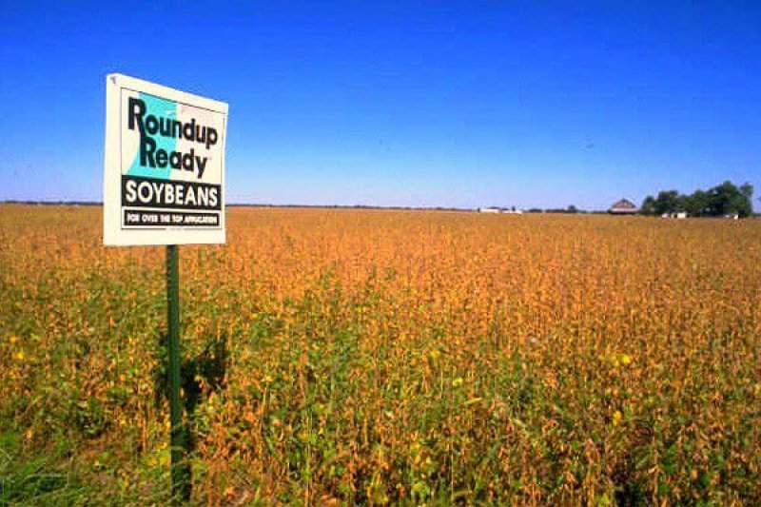
GMOs Improve the Agricultural Impact on Ecosystems
Point #1:
Herbicide Tolerance
Herbicides: chemical-based weed killers; toxic to unwanted plants and crops
GMO Characteristic: “Roundup Ready”
Roundup: Glyphosate compound; highly effective, powerful, broad herbicide (kills most plants)
GMO soybeans: Roundup tolerant
Only one herbicide needed
Can be planted in less ideal areas (i.e. weed-prone)
https://royalsociety.org/topics-policy/projects/gm-plants/which-genes-have-been-introduced-into-gm-crops-so-far-and-why/

Slide 11
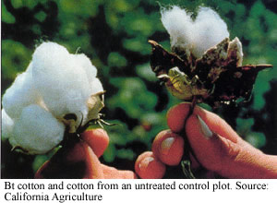

GMOs Improve the Agricultural Impact on Ecosystems
Point #1:
2) Insect Resistance
Insecticide sprays: topical chemical (or Bt) treatment to kill insects - crop pests and some beneficial insects (e.g. pollinators)
GMO Characteristic: “Insecticidal Plants”
Plants contain Bacillus thuringiensis (Bt) toxin – disrupts gut function of insects, kills specific pests (‘target pests’) who eat certain crops
GMO cotton: most in US contains Bt
Significantly reduces insecticide spray needs
GMO eggplant: India
https://royalsociety.org/topics-policy/projects/gm-plants/which-genes-have-been-introduced-into-gm-crops-so-far-and-why/

Slide 12
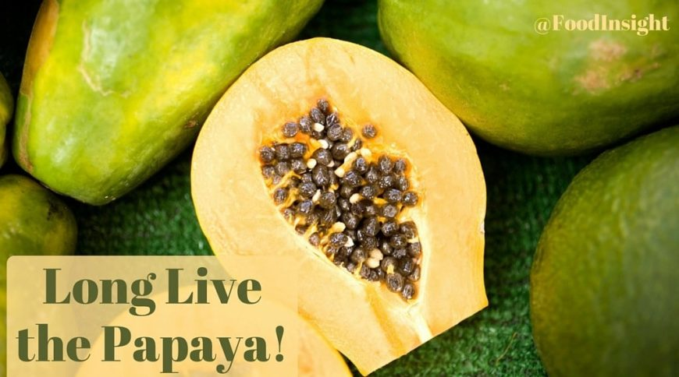
GMOs Improve the Agricultural Impact on Ecosystems
Point #1:
3) Virus and Fungus Resistance
Plant viruses and fungi: destroy millions of crops, especially fruit
No known naturally resistant fruit cultivars
GMO Characteristic: “Viral Gene Insertions” and “Antifungal Genes”
Creates resistance to specific plant viruses and fungi
GMO papaya: Hawaiian crops now resistant to Ringspot virus
Significantly increases papaya production
GMO potatoes: resistant to blight (fungal rot)
Reduces fungicide use by up to 90%
https://royalsociety.org/topics-policy/projects/gm-plants/which-genes-have-been-introduced-into-gm-crops-so-far-and-why/

Slide 13
GMOs Disrupt the Natural Ecosystem/Environment
Counter-Point #1:
↑ GMOs
↑ Herbicides
↓ Genetic Variability
Ecosystem Disruption
↑ Ecosystem
Toxicity
↑ Susceptibility to novel pathogens
(-) non-target
(insects, birds, etc.)
(-) target plants or other animals

Slide 14
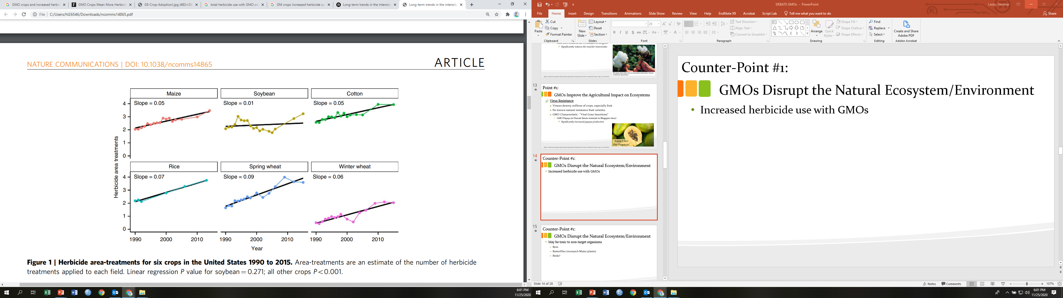
GMOs Disrupt/Harm the Natural Ecosystem/Environment
Counter-Point #1:
Does herbicide use increase with GMOs
YES

Slide 15
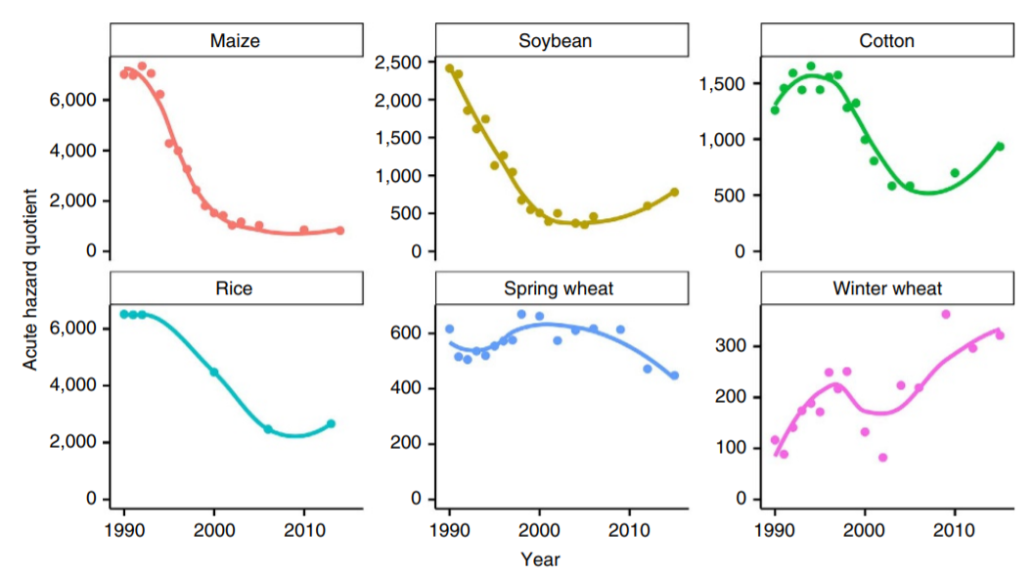
GMOs Disrupt/Harm the Natural Ecosystem/Environment
Counter-Point #1:
NO
Does herbicide toxicity increase with GMOs?

Slide 16
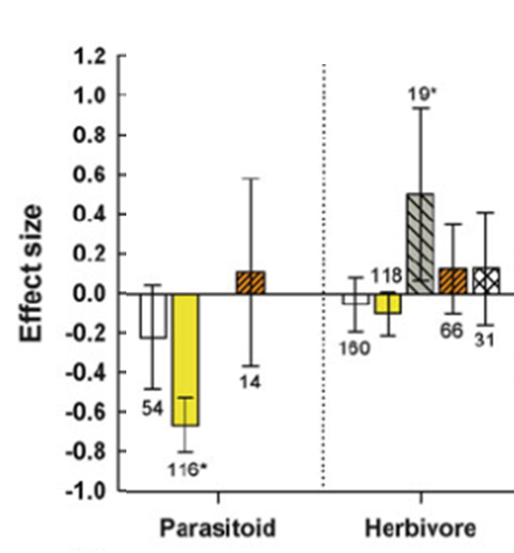
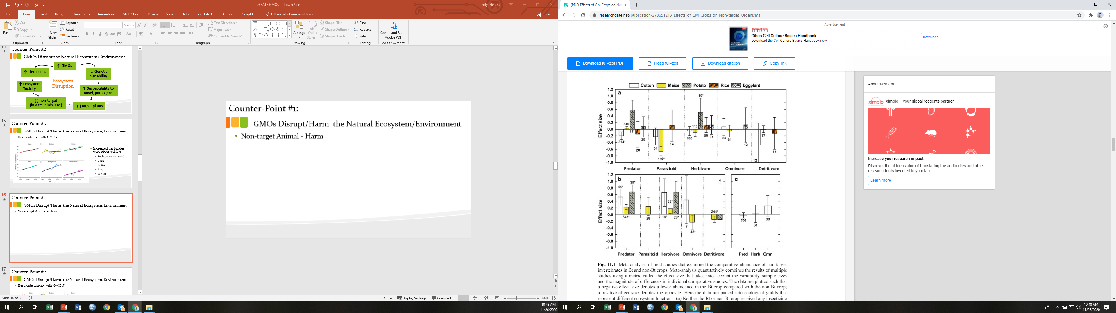
GMOs Disrupt/Harm the Natural Ecosystem/Environment
Counter-Point #1:
Are non-target animals getting harmed?
NO
Impacted? YES
Above the Line =
GMOs increase the population
Below the Line =
GMOs decrease the population
file:///C:/Users/hl26546/Downloads/NaranjoGMBook2014.pdf

Slide 17
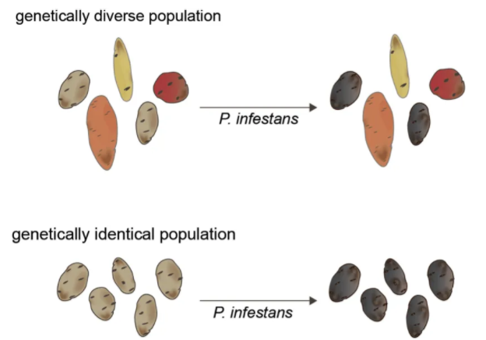
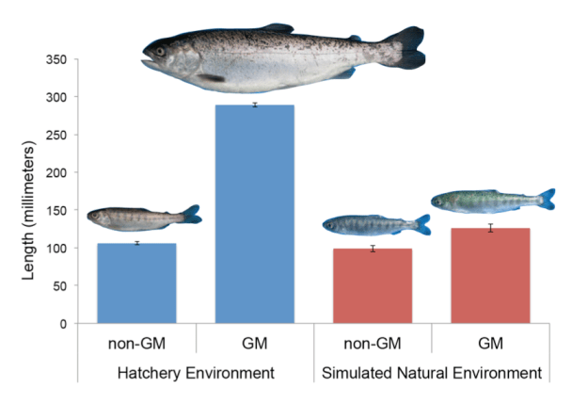
GMOs Disrupt/Harm the Natural Ecosystem/Environment
Counter-Point #1:
YES
Do they reduce genetic variability?
Example: 1800s Ireland Potato Famine
Example: GM Atlantic Salmon
http://sitn.hms.harvard.edu/flash/2015/challenging-evolution-how-gmos-can-influence-genetic-diversity/

Slide 18
GMOs Disrupt the Natural Ecosystem/Environment
Counter-Point #1:
↑ GMOs
↑ Herbicides
↓ Genetic Variability
Ecosystem Disruption
↑ Ecosystem
Toxicity
?
↑ Susceptibility to novel, pathogens
?
(-) non-target
(insects, birds, etc.)
?
?
(-) target plants or other animals

Slide 19

Questions?

Slide 20
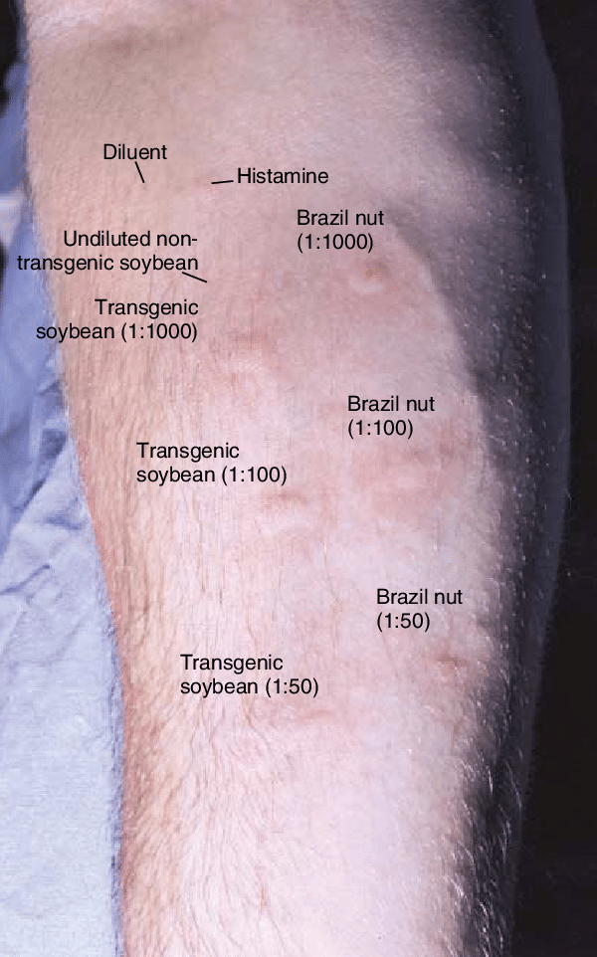
GMOs have the potential for serious health risks
Point #2:
Allergic Reactions
Allergens can transfer from foods that people are allergic to into ‘safe’ foods
Example: GMO Soybeans from Brazil Nuts
(in someone allergic to Brazil Nuts)
New allergens will form.
https://www.centerforfoodsafety.org/issues/311/ge-foods/ge-food-and-your-health

Slide 21
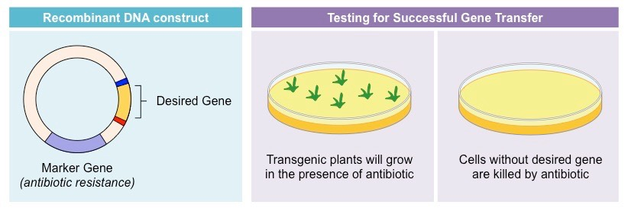
GMOs have the potential for serious health risks
Point #2:
Antibiotic Resistance
Most GMO food contains ‘antibiotic resistance markers’ to ID the genes
These markers could make antibiotics ineffective
GE Maize (Novartis) includes ampicillin-resistance gene
Resistance could move from bacteria in corn to food chain
https://www.centerforfoodsafety.org/issues/311/ge-foods/ge-food-and-your-health

Slide 22
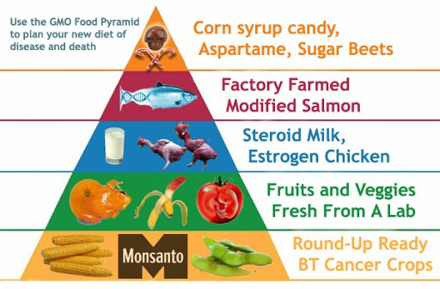
GMOs have the potential for serious health risks
Point #2:
Cancer (not directly from GMO foods) but:
GE recombinant Bovine Growth Hormone (rBGH)
Increased IGF-1 (cows milk)
IGF linked to
breast cancer
prostate cancer
colon cancer
Increased herbicide use (Round-up)
https://www.centerforfoodsafety.org/issues/311/ge-foods/ge-food-and-your-health

Slide 23
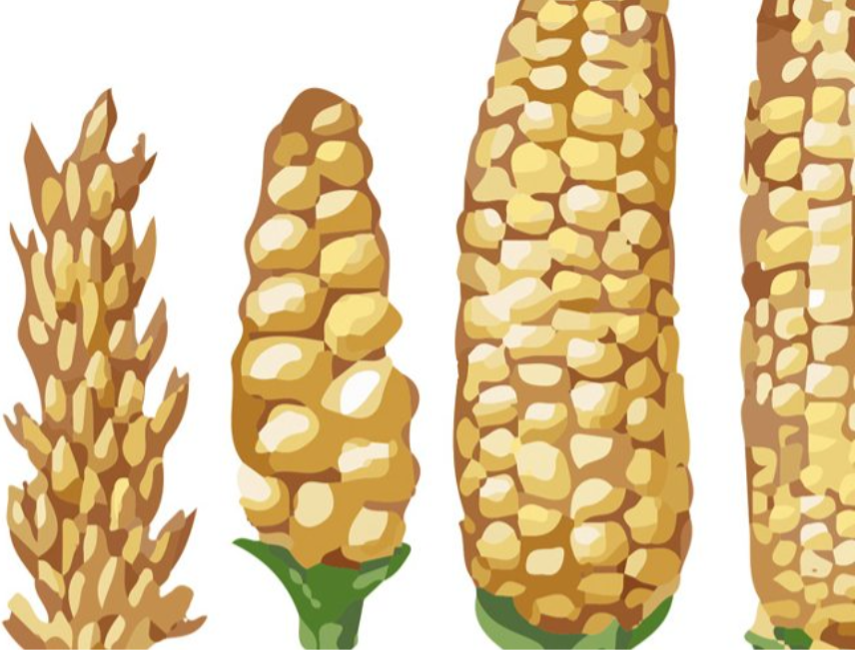
GMOs Have Not Been Proven to Show Harm
Counter-Point #2:
Genetic modifications have existed as long as agriculture has existed → traditional cross-breeding and grafting, both within and between species
Takes longer (multiple generations), but same end result
Bioengineered foods have been around for 40+ years:
Wine, cheese, medicine, plants…
Not ONE reported case of harm to human health or the environment

Slide 24
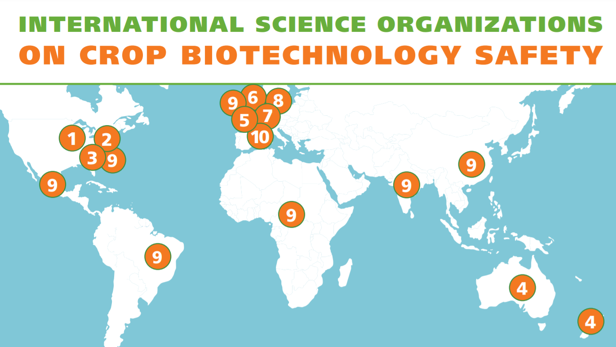
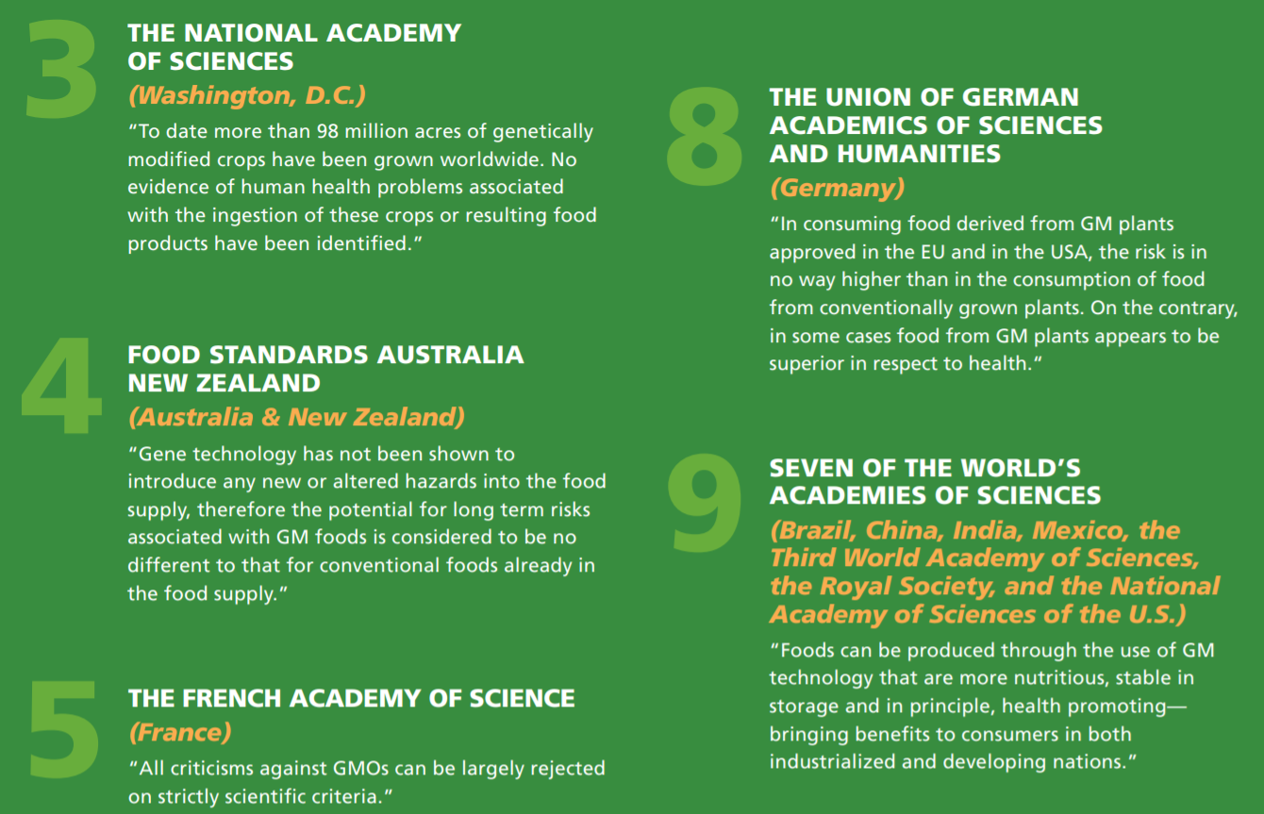
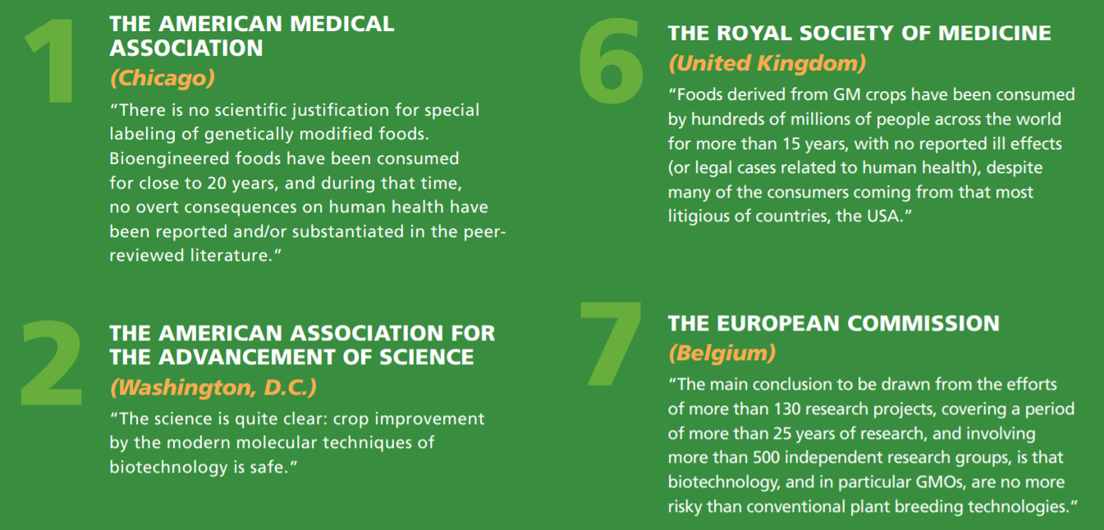
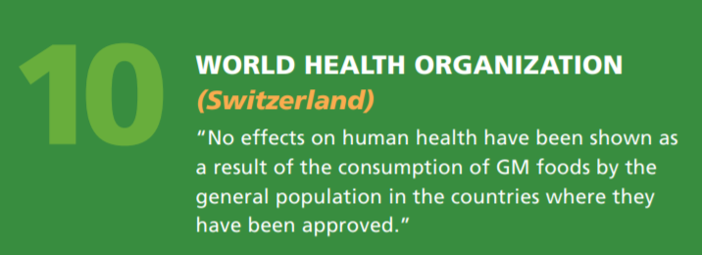
GMOs Have Not Been Proven to Show Harm
Counter-Point #2:
After thousands of studies, every major scientific organization in the world agrees: Currently available GM foods are not a health risk, and the process of genetic modification is not more risky than traditional plant breeding

Slide 25
Questions?

Slide 26
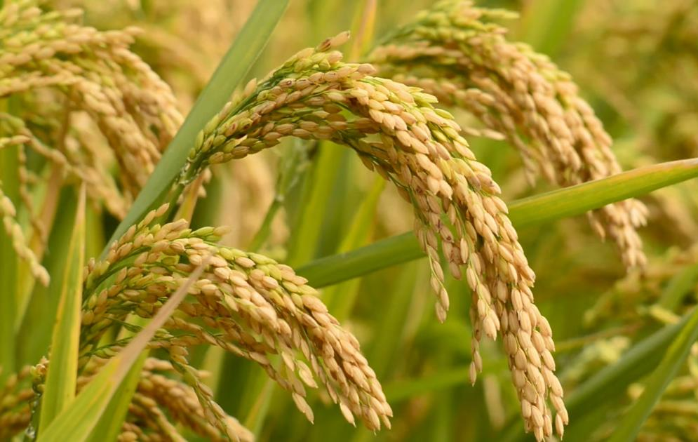
Essential for Global Food System
Point #3:
Increased production potential
Less need for costly pesticides/herbicides/fungicides on GMO crops
Virus resistant
Drought (or flood) tolerant
Canola, cotton, maize, rice: global staple foods, necessary for survival of subsistence farmers
More grain per stem, stronger/shorter stems
More food in the same ‘footprint’
Less need for synthetic NPK fertilizers
Maize, rice (traditional breeding = wheat, rice)
Longer “shelf-life” in non-ideal storage conditions
Resistant to pests post-harvest

Slide 27
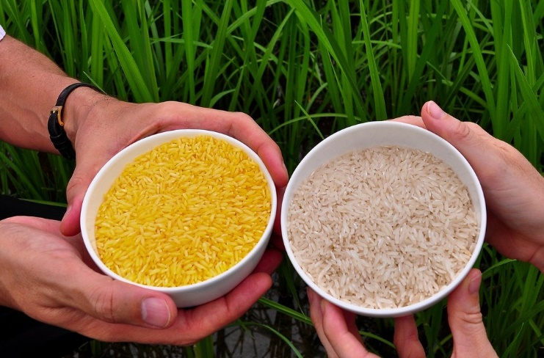
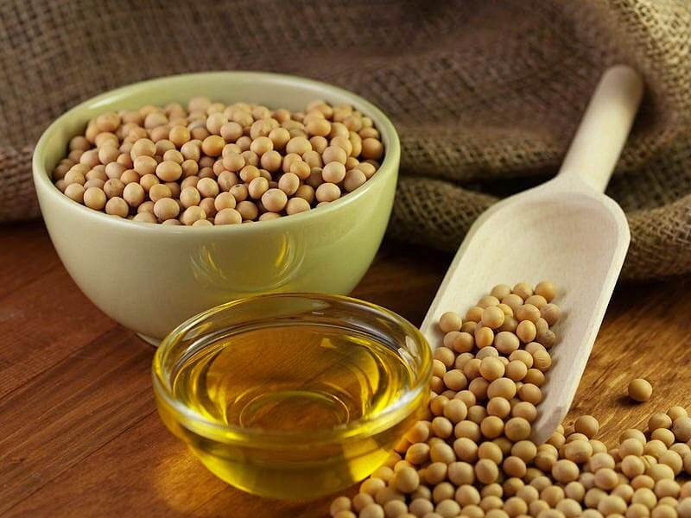
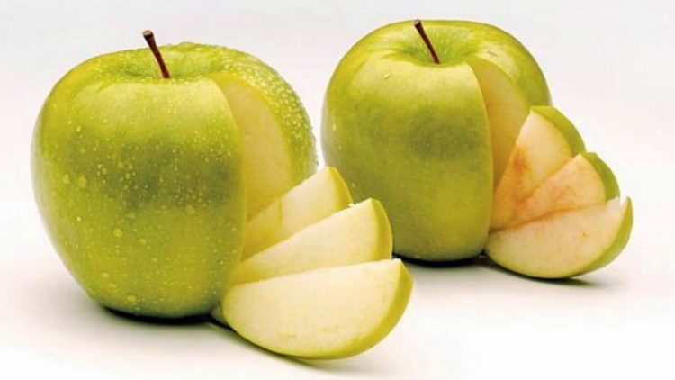
Essential for Global Food System
Point #3:
Insertion of vitamins and minerals
Golden Rice – beta carotene (Vitamin A precursor)
Preventing blindness and death in young children (Southeast Asia)
Soybeans - produce healthier oil
Less trans fat, more monounsaturated fat (United States)
Consumer appeal
Apples do not brown when cut
Less food waste

Slide 28
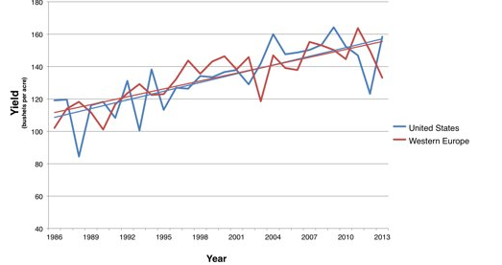
Not essential & problematic
Counter-Point #3:
Not needed in the US
Example: GM Atlantic Salmon
Example: GMO Corn
GMO
https://www.ewg.org/agmag/2015/03/claims-gmo-yield-increases-don-t-hold

Slide 29
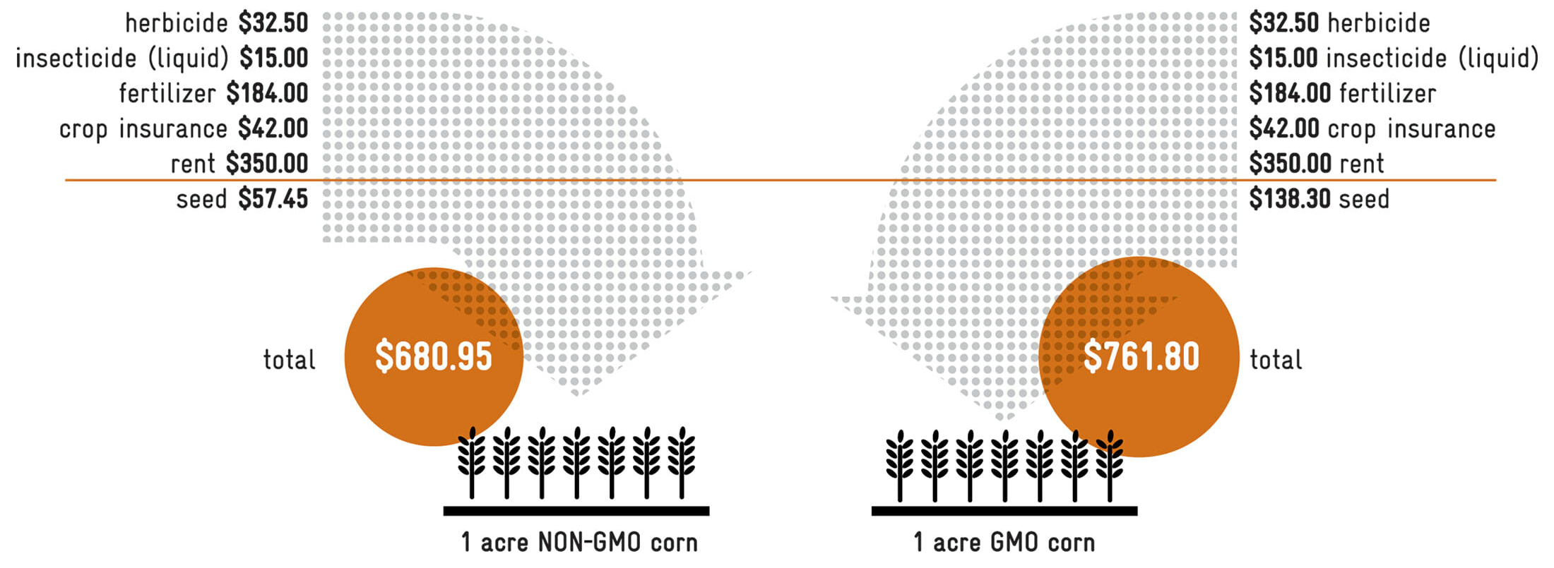
Not essential & problematic
Counter-Point #3:
In the US, the use of GMOs is still more costly with comparable yield (in some cases)
In developing countries, the use of GMOs creates a reliance which is:
Expensive technology
(Sometimes) unavailable technology
Dependent on a few large companies (who control cost, availability, etc.)

Slide 30
Questions?

Slide 31

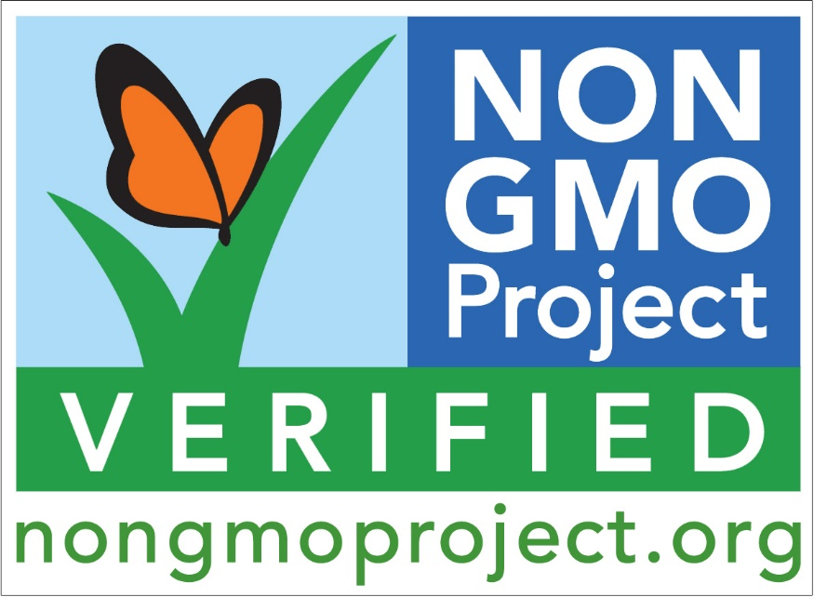
Lack of Labelling and Regulation
Point #4:
FDA’s position
Foods produced through biotechnology or cloning not substantially different
1-2 gene difference
Treated the same
GRAS listed
Labelling:
Prior to 2020: no labelling required (may convey erroneous message of harm)
Jan, 2020: New Label (required by Jan, 2022)
Still confusing…………………. Why?
Non-GMOs are labelled!

Slide 32

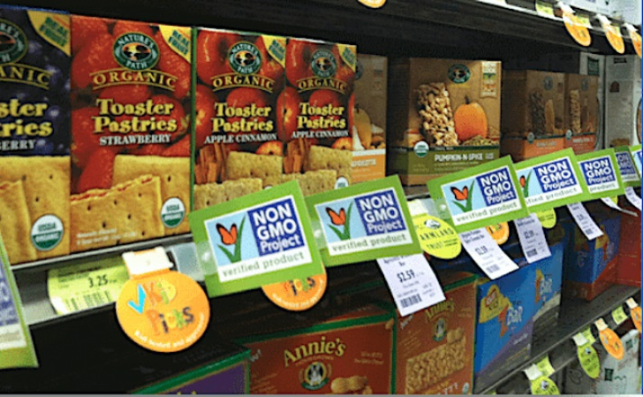
Regulations and Consumer Power
Counter-Point #4:
Companies may use “Non-GMO Project” label
Beware of increased prices – remember only certain plants have GMO varieties (e.g. not wheat!)
Jan 1, 2020: National Bioengineered Food Disclosure Standard
GM foods produced in certain ways require disclosure via text, symbol, electronic link (e.g. QR code), phone number, website
How can customers inform themselves?
94% soybeans = GMO
92% corn = GMO
95% canola = GMO
99.9% sugar beets = GMO
If you eat processed foods, you are likely eating GMOs!

Slide 33
Questions?

Slide 34
InstaPoll
Taking everything into consideration, which side do you now support?
GMO foods are safe to eat and beneficial for agricultural production.
Even though GMOs have not been proven to be unsafe, I still don’t want to eat them.
There are still too many unknown factors around GMOs – get those things out of my food!
Not sure

Slide 35
Wrap-up
Infographic Project: DUE Today, 4/29
Submit Peer Review Form via Canvas Assignments
Position Summary #3 (GMO debate): DUE Thurs, 5/6
Final Exam
Live Review Session: Thurs, 5/6
Exam opens: Fri, 5/7 @ 12:01 am
Exam closes: Wed, 5/12 @ 11:59 pm (NO EXCEPTIONS)
Don’t forget today’s Learning Check!
Instapoll results…

